Slide 1
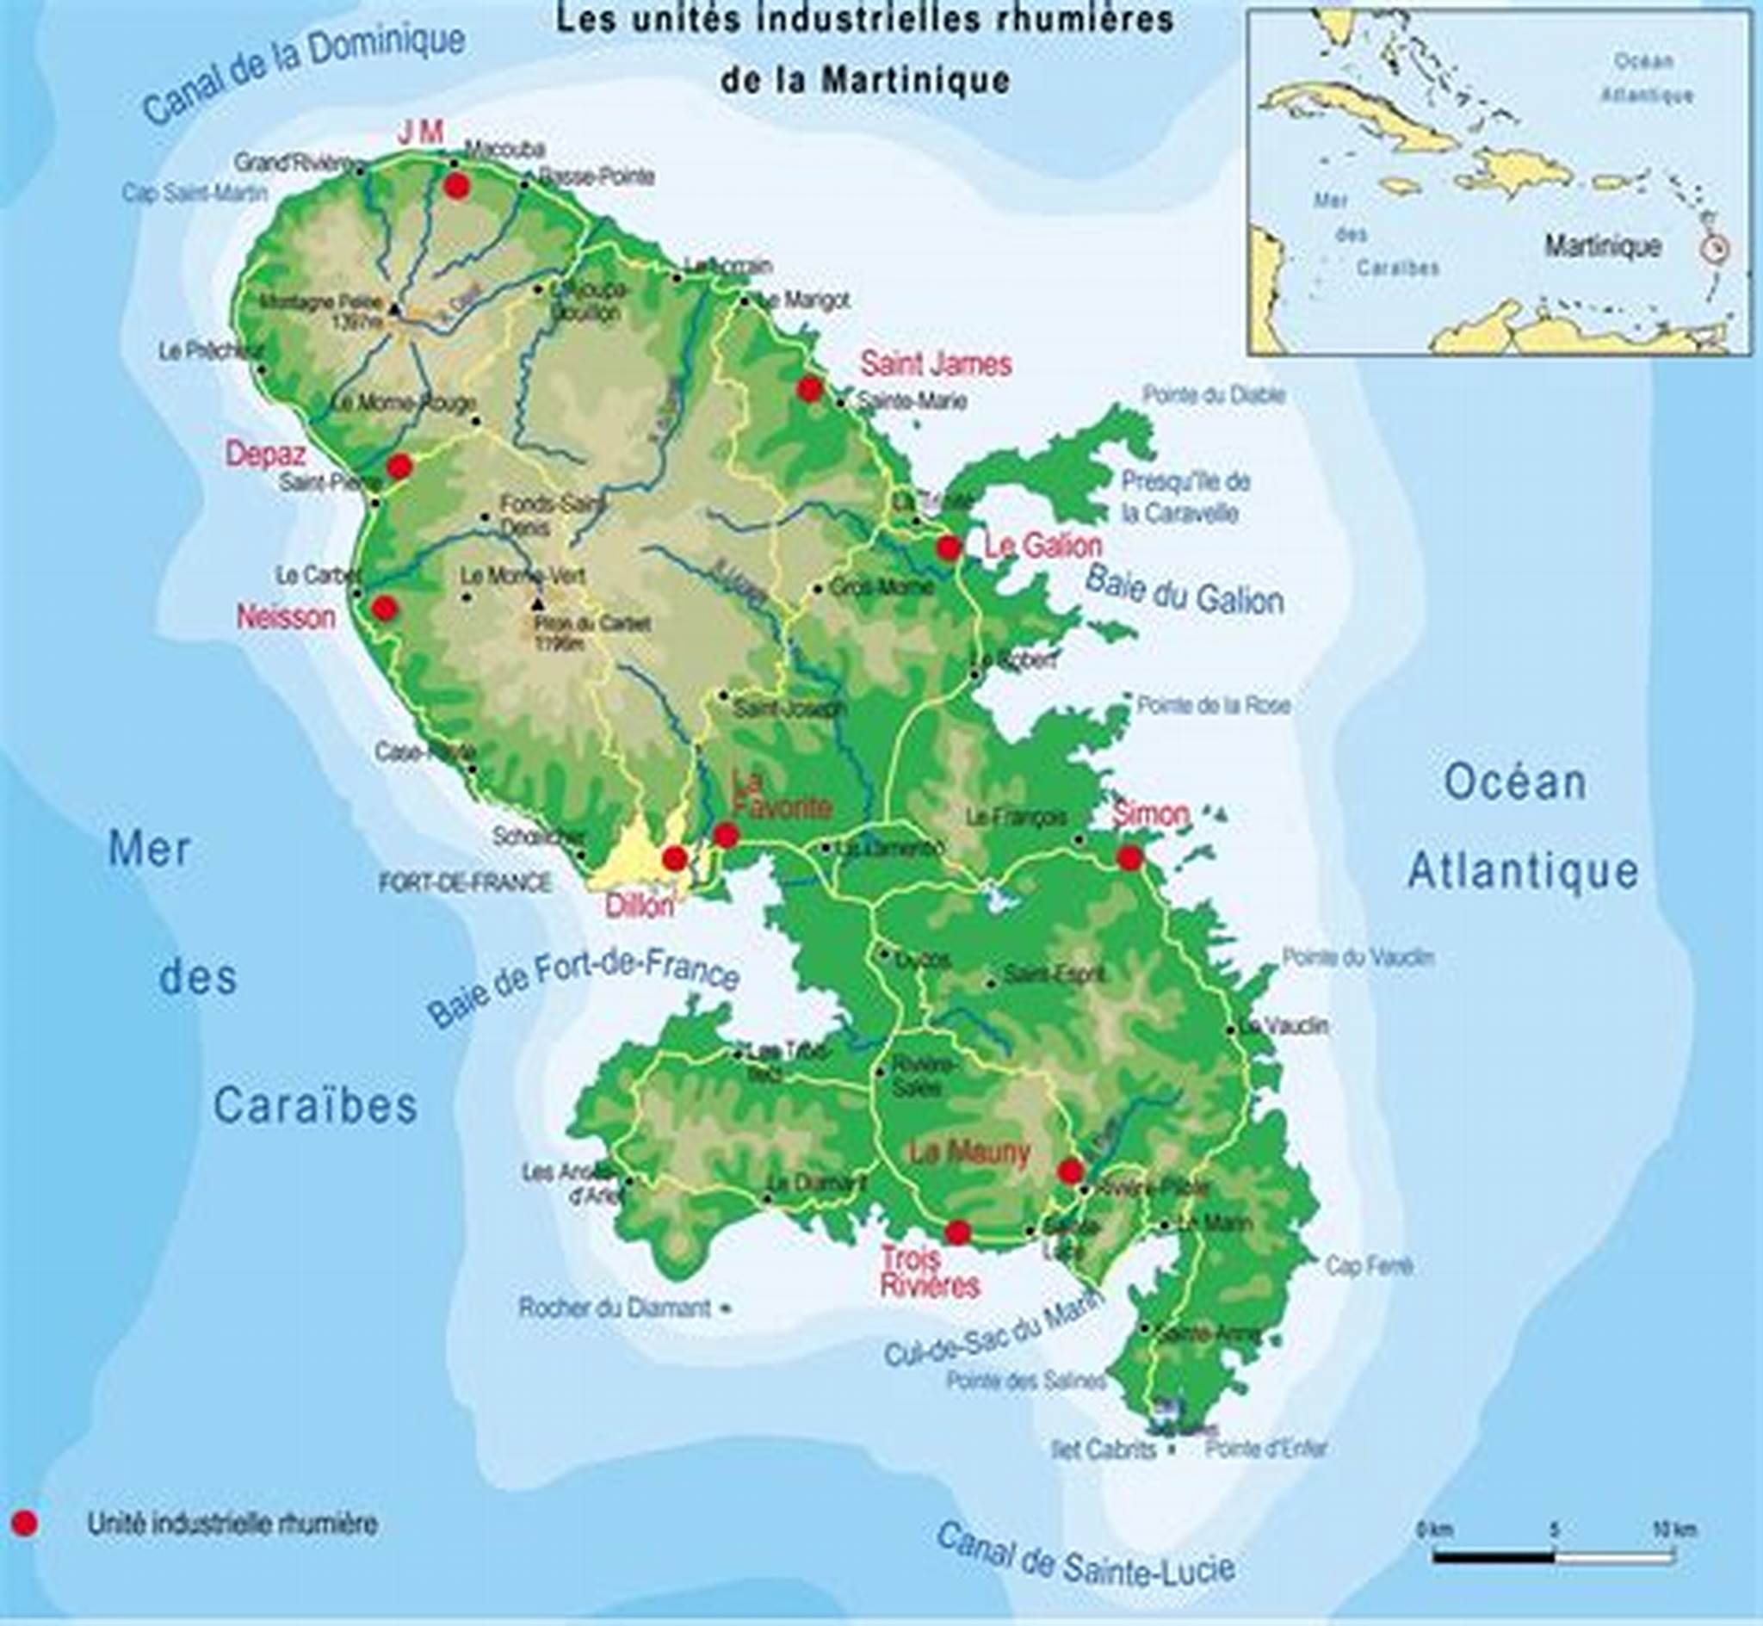
CULTURE IN
Martinique

Slide 2
LANGUAGES
Martinique, is an overseas department and region. French is the official language on the island as well as throughout the territory of the French Republic. Nevertheless, the vast majority of the population also speaks Creole.

Slide 3
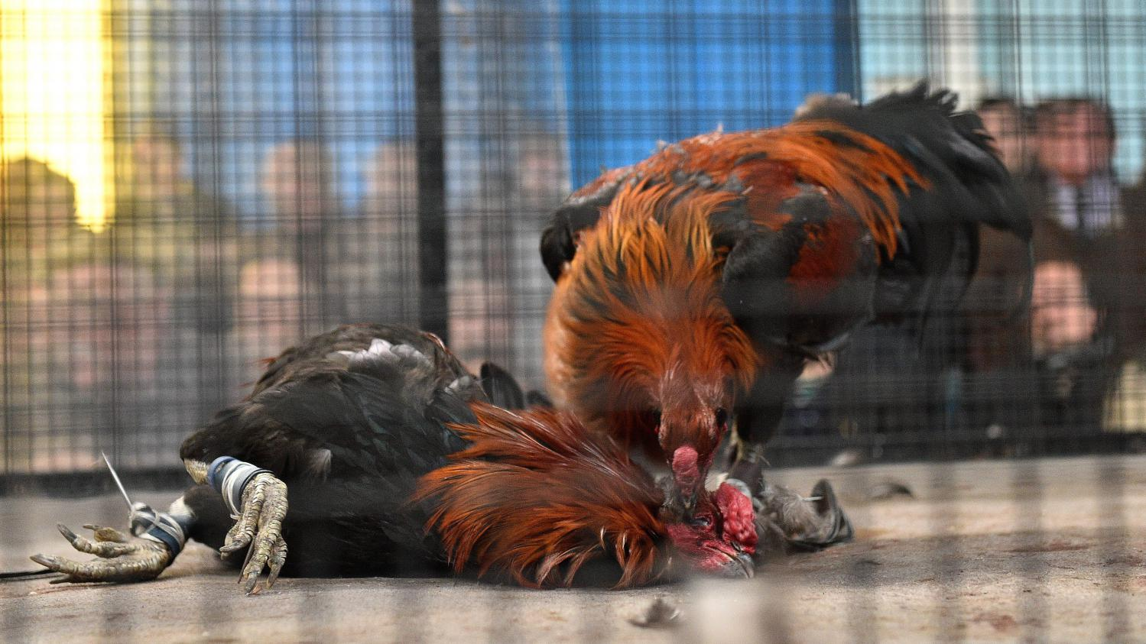
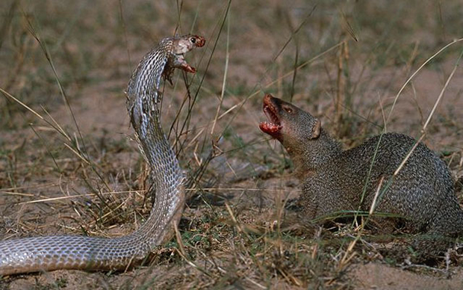
TRADITIONS
The tradition of the fighting of Roosters is very vivid in Martinique, the season lasts from November to July. The fighting takes place in small arenas named Pitts.
Fights between a snake and a mongoose are also organized in the image of the rooster fights, but the difference is that you don't bet money.
Those traditions are yet disappearing.

Slide 4
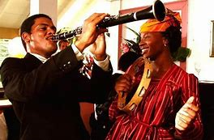
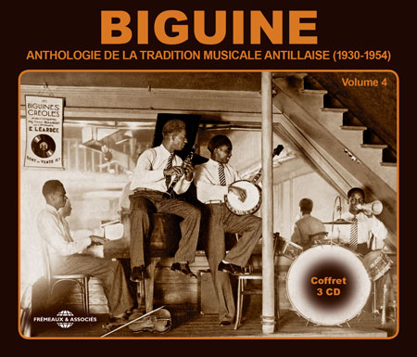
MARTINIQUE MUSIC
The music of Martinique has its origins in music from Europe and Africa.
In traditional music we know mainly the music of the Carnival of Martinique and the Biguine, bèlè and zouk (use the link to listen)
Zouk: https://www.youtube.com/watch?v=YobFkm-wugg

Slide 5
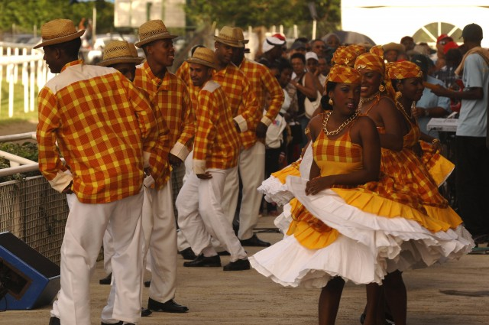
TRADITIONAL DANCE
The Bèlè is an artistic practice that emerges in Martinique after the abolition of slavery.
It is the legacy left by our ancestors who lived in the vicinity of the cane plantations. It is the beating of the drums that imposes the steps on the dancers. The dance steps are accompanied by the rhythm of the TI-BWA given by two chopsticks that strike the rear part of the drum. The only condition in this dance is the respect of the measure, apart from that the approach of the gesture is free.

Slide 6
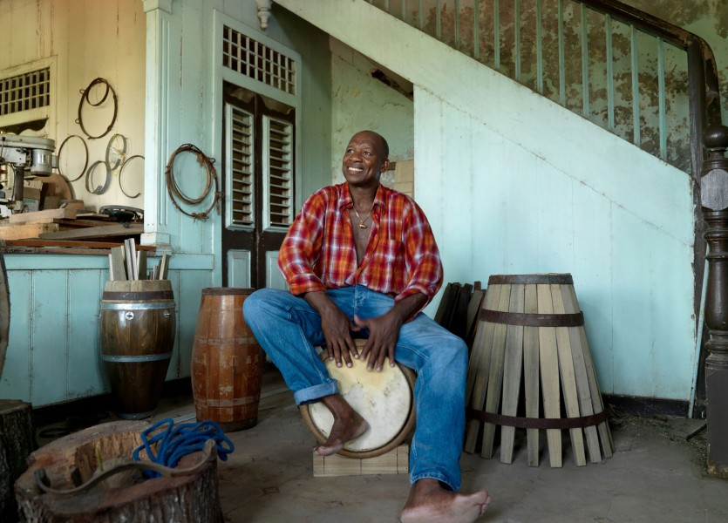
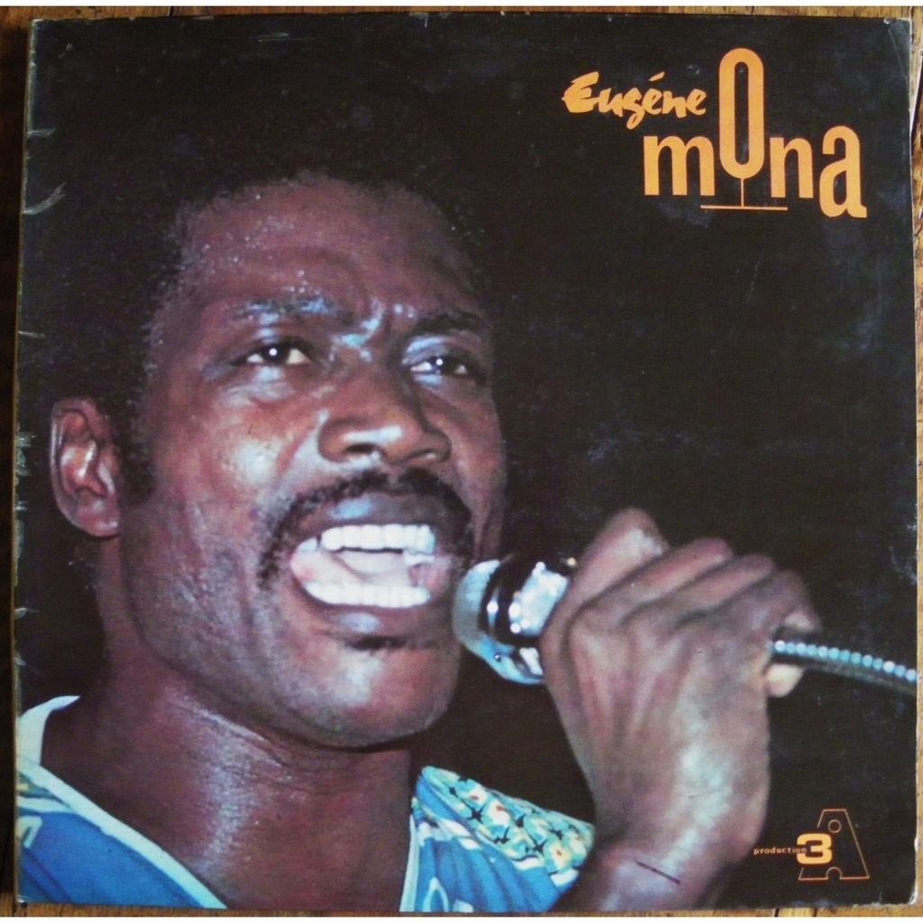
This man plays the traditional drum used in Bèlè.
https://www.youtube.com/watch?v=IMWIA19gzuU
A traditional singer of bèlè, he’s dead
Listen: https://www.youtube.com/watch?v=d3nuXhPCA74

Slide 7
TYPICAL DISHES OF MARTINIQUE

Slide 8
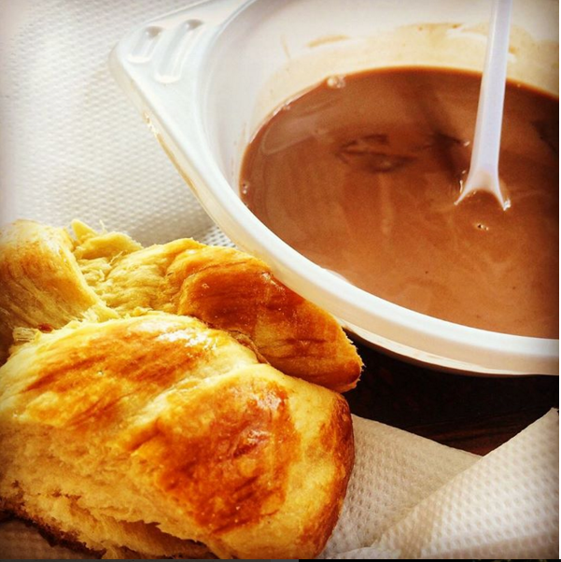
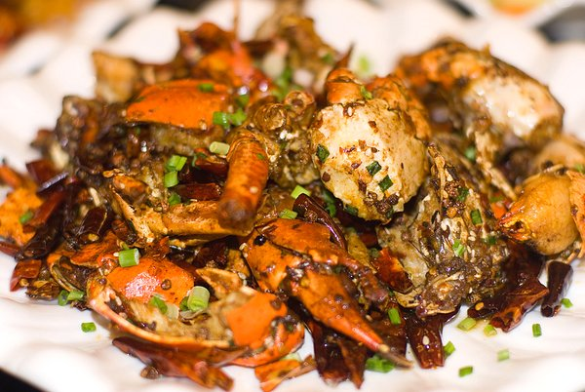
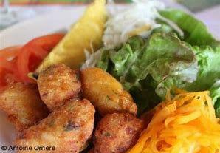
Butter bread and chocolate
It’s traditional during parties(weddings, family reunions,etc…)
Matoutou of crabe.
Traditionally eaten during Easter at beach or family reunions.
Accras of titiris(titiris are a fish)
Eaten as a stater.

Slide 9
Thanks for watching our slide

